Slide 1
CSE 628 – Project Update 1
Will your blog post appeal to the world?
An inference and estimation of popularity of a blog post based on analysis of its content
- Manisha Kamal, Nilesh Poddar and Purvesh Sahoo

Slide 2
Motivation and Tasks
Help predict success/failure of a potential blog post
Help improve marketing strategy for a new product launch
Little research done
Specifics:
Domain: Technology
Url: www.reddit.com
Tasks:
Metadata collection
Data collection – Training and Test
Feature identification
Training (In the process)
Testing
Analysis and improvement
Enhancements

Slide 3
Data
Metadata and pre-processing
Score (Upvotes - Downvotes), title, domain, url, timestamp for each valid post in a timeframe considering sorted by ‘Top’ – JSON format output using reddit API
Top 100 and Bottom 100 based on score as training data
Data
Goose content scraper
Ignore non-blog items like images, videos, etc.

Slide 4
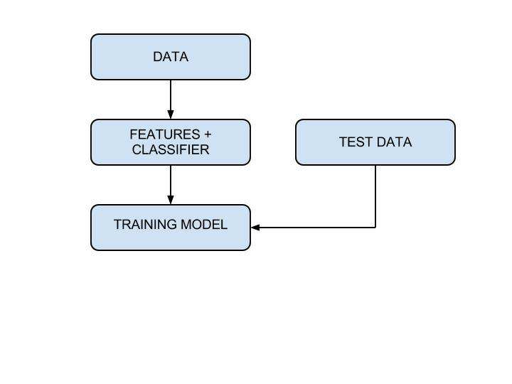
Implementation
Features
Unigram
Bigram
Trigram
POS
POS + bigram
POS + trigram
Bag of words
Normalization
POS + Title + bigram
POS + Title + trigram
Pre-process
5 folds – training and test in each
Each fold – 240 training + 60 testing
Alternate entries from Top and Bottom 150 entries

Slide 5
Implementation continued…
Specs
Tool: Weka
Classifier: LibSVM or Naïve Bayes
Packages: OpenNLP
OS: Windows/Ubuntu
Language: Java
Other details
Nested cross validation
Normalization

Slide 6
Progress so far
Only unigram - Attempted
Only bigram - Attempted
Only trigram - Attempted
Only POS
POS + bigram
POS + trigram
POS + Title + bigram
POS + Title + Trigram
Normalization
Bag of words

Slide 7
Tasks to complete
Train on more features
Nested Cross validation
Testing
Analysis and improve accuracy
Experiment on different time periods
Analyze the effect of custom features like “Title of the post”

Slide 8
Future scope
Try on other domains of blog posts to observe variations
Cases like 1)Tagline for an advertisement of a product, 2) Movie title popularity estimation and other marketing strategies

Slide 9
Acknowledgements and References Grateful to Prof. Yejin Choi, TA Ritwik Banerjee 1http://www.cs.cornell.edu/~cristian/memorability_files/memorability.pdf 2 http://en.wikipedia.org/wiki/Blog 3 https://developers.google.com/custom-search/v1/overview 4 https://dl.acm.org/citation.cfm?id=1937087 5 www.fbe.hku.hk/~mchau/papers/Blog_WITS2009.pdf 6 www.reddit.com/r/technology 7 https://github.com/jiminoc/goose Thank you!

